Slide 3
Session One: Stand up and be counted
Can you think of a cause or campaign (serious or light-hearted) that you feel/could feel particularly committed to?

Slide 4
Insert Video Clip 1 here…

Slide 5
Discipleship school
On the illustration showing motorists (coming up in a moment), which image best represents your own discipleship?
How much do you feel you've already learnt?
What things do you feel you still need to discover or learn?
What things make following Jesus easy and difficult?
Where are the particular challenges or issues?

Slide 6
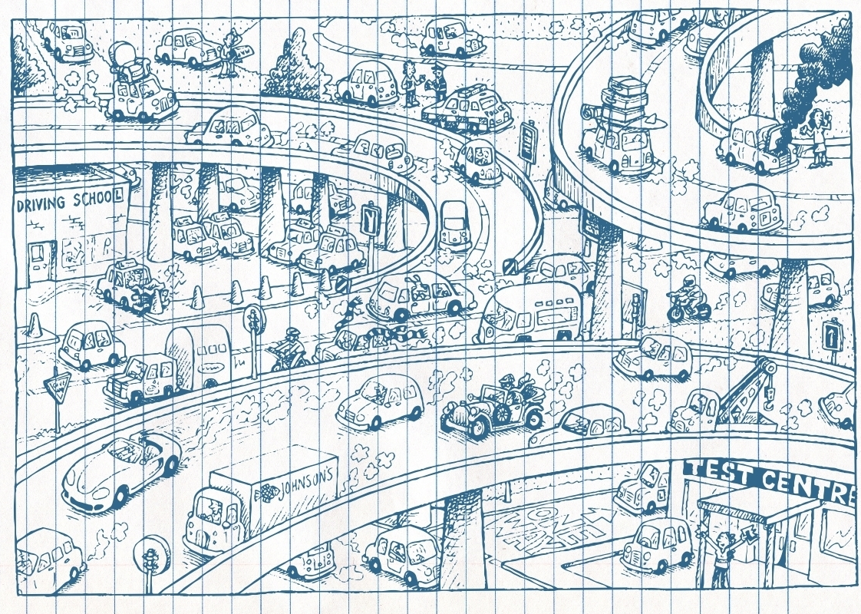

Slide 7
Dabbling or disciple?
Then Jesus said to his disciples, 'If anyone would come after me, he must deny himself and take up his cross and follow me. For whoever wants to save his life will lose it, but whoever loses his life for me will find it.’
(Matthew 16:24-25)
If you were going to rate yourself as a follower of Jesus how 'full' or 'empty' is your commitment? Draw a line on the 'fuel gauge’ in your members notes and shown on the next slide.

Slide 9
Telling others
Can you think of three people who are not yet followers of Jesus?
Why not start to pray for them on a regular basis and look for opportunities to speak about your own faith with them.
Write down their names in your participant’s manual.

Slide 12
Welcome and review

Slide 13
Word association
What ideas come to mind when we hear the word 'church’?
How do you react to the following statement? 'Church is what is left behind when you take away the buildings.’
What do you most value about your local church?

Slide 14
Insert Video Clip 2 here…

Slide 16
Further on and deeper in!
Where do you feel you are at the moment?
Where would you like to be?
Take a moment or two to make a decision and place yourselves on the diagram in your participant’s manual. You can choose one of the words on the picture or put come up with another one.
Then chat in pairs or all together, inviting each person to say where they would put themselves and why.

Slide 19
Building Blocks
In the chat facility of Zoom (if you know how – if not then you could send a text message or similar to the person leading this course for you) write your name and a word that symbolises, for you, your place in the Body of Christ, the Church.
Maybe that word is something like: welcome, love, hospitality, children, serving, caring, etc.

Slide 20
Reflection
This is a similar reflective exercise to that of the previous session using John's Gospel. This time we use 1 Peter 2:4-5.

Slide 22
Welcome and review

Slide 23
Church - how is it for you?
Can members remember the first word that came into their head last session when they thought about church? Has their word changed?

Slide 24
Church - how is it for you?
'Some people go to church looking like they are on the way to the dentist and come out looking like they have been.'
'That was about as interesting as a watching paint dry!' - a choral evensong service fails to inspire!
'Sunday is the best day of the week! I love worshipping God with my friends at Church'
Vicar at the church door: 'I guess you found that a bit weird and wonderful?' Visitor: 'Weird? Yes! Wonderful? No!' - a less than positive reaction to a service of prayer and praise.
'Daddy is it still Sunday?' - eight year old's comment during a very long and dull service.
'I felt like I saw a glimpse of heaven. It was wonderful’

Slide 25
Church - how is it for you?
Discuss together as a whole group.
How do you react to the statements on the last slide and in the participant’s manual?
Do they ring any bells?

Slide 26
Insert Video Clip 3 here…

Slide 27
In the mix
From the passage on the next slide it is possible to identify some of the following ingredients which are part of 'the recipe' that makes up an act of worship.
Complete the chart the follows answering the following questions:
Why do you think we do these things?
What's your response to that part of a service?

Slide 28
In the mix

Slide 29
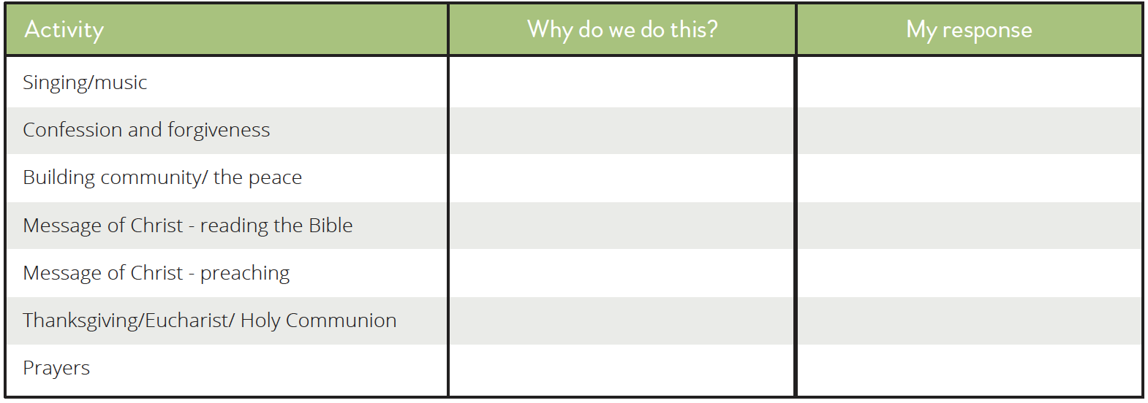
In the mix

Slide 30
Taste comparison
From the chart you filled in pick two activities which you find easy/enjoyable in worship and one you find more difficult.

Slide 31
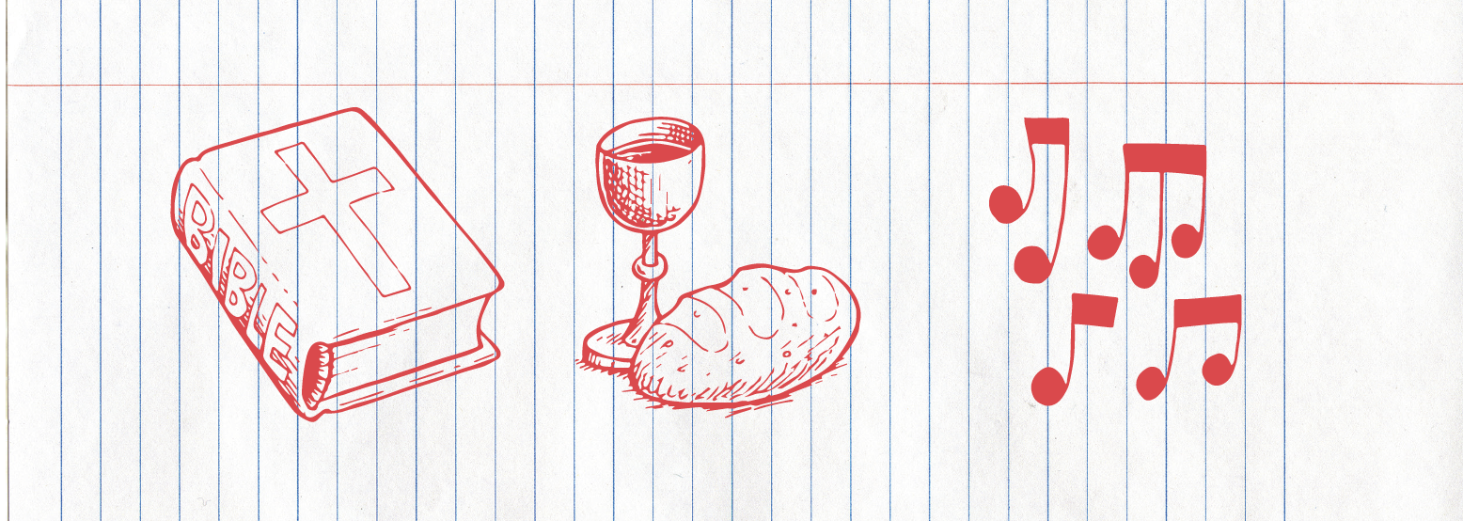
Holy Communion, Bible and Music

Slide 32
Better together
In our last session you may recall we added our names and a word to the chat function as a reminder of the idea of the church as being a network of relationships. Have a member of the group read the verse from last session.

Slide 33
Better together

Slide 34
Better together

Slide 35
Better together
Discuss together the following points
— that without people being present at worship the church is weaker.
— that worship is more to do with what we contribute than what we get out of going to church.

Slide 36
Reflection

Slide 38
Right here, right now
Which of the following phrases best describes your daily relationship with the Lord?
Works when I'm in the mood
Good days and bad days
Not what it used to be
Cooking on gas
Regular and fruitful
Patchy
Deep and meaningful
Wearing L plates
Non-existent
Hmmmm!

Slide 39
Insert Video Clip 4 here…

Slide 40
God’s greenhouse
Fill in parts of the chart to describe your own ways of growing in God. What's going well, what could improve, what could you try, what doesn't work for you?
(The chart is on the next slide and on page 55 of the Participant’s manual)

Slide 41
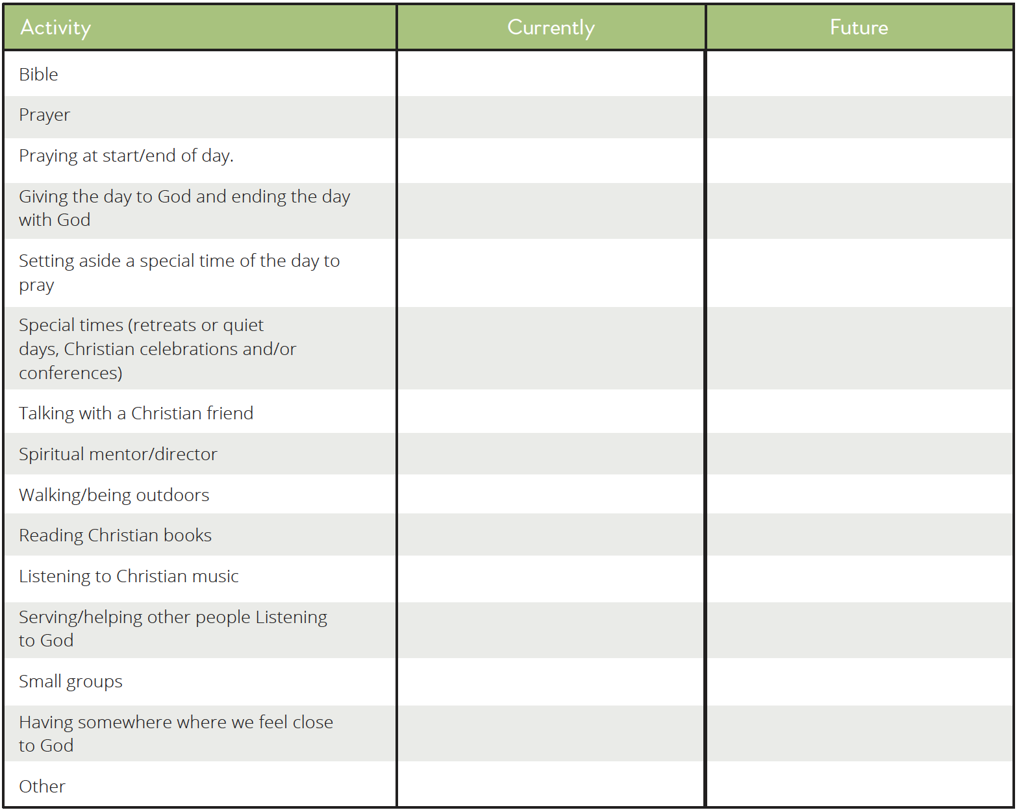

Slide 42
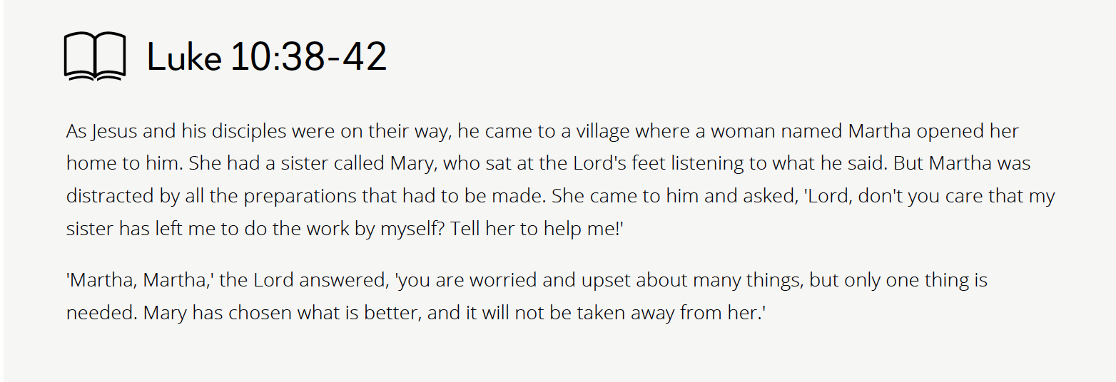
Mary and Martha

Slide 43
Mary and Martha
How do you react to this passage?
What encourages you?
What questions does it raise?
What impression do you have of Mary? Martha?

Slide 44
Mary and Martha
Where do you think you might be on the scale?

Slide 45
A time and a place
It is sometimes said that 'A person who is too busy for God is too busy'.
Yet we read many examples in our Bibles of people interrupting the flow of their day in order to pray. For instance:

Slide 46
A time and a place
How do you react to these statements? Is there a particularly good time and place for you to have a regular time to pray and read the Bible?
Share experiences.

Slide 47
Reflection

Slide 49
Welcome and review

Slide 50
Introduction: Who is the Holy Spirit?
The third person of the Trinity, an equal partner in the Godhead along with the Father and the Son.
The Father, Son and Holy Spirit can be thought of in terms of an equilateral triangle. All the angles and sides are exactly equal - making it the most stable shape in engineering and building.
But the Trinity, unlike a triangle in building, is not a static object. The Trinity is more like a community-a dynamic relationship between three persons, constantly moving and interacting.

Slide 51
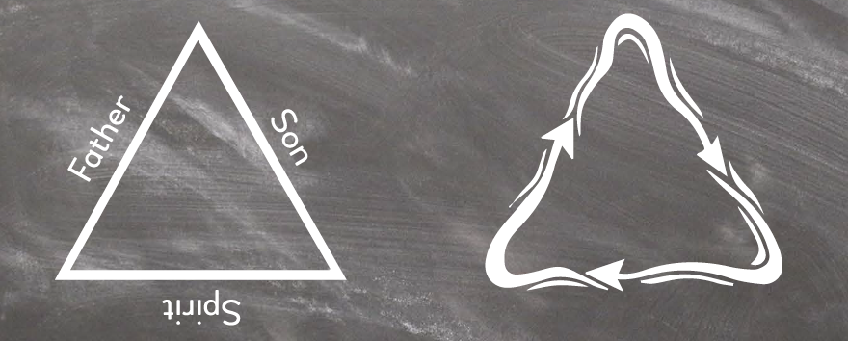
Introduction: Who is the Holy Spirit?
The third person of the Trinity, an equal partner in the Godhead along with the Father and the Son.
The Father, Son and Holy Spirit can be thought of in terms of an equilateral triangle. All the angles and sides are exactly equal - making it the most stable shape in engineering and building.
But the Trinity, unlike a triangle in building, is not a static object. The Trinity is more like a community-a dynamic relationship between three persons, constantly moving and interacting.

Slide 52
Insert Video Clip 5 here…

Slide 53
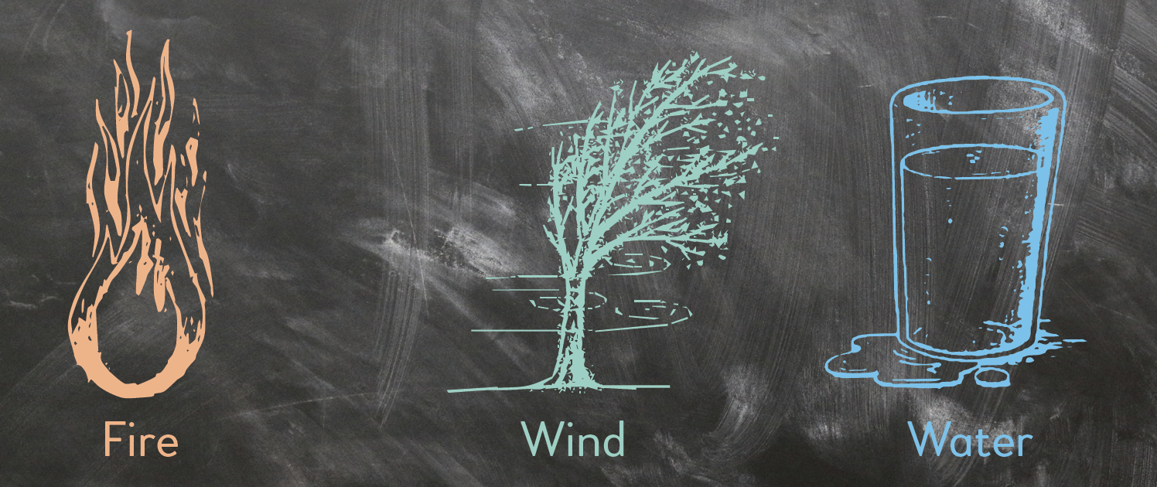
A picture paints a thousand words

Slide 54
The Spirit then and now
in the Old Testament not every believer was seen as being personally blessed with the Spirit
at certain times, great leaders such as David, Moses, Elijah and Samson had an experience of the Spirit to equip them for a special occasion
the Old Testament looked forward to a time when the Spirit would be poured out on all of God's people (Joel 2:28)
the New Testament begins with a flurry of activity by the Spirit and the end of Jesus' earthly ministry is marked by the promise of the gift of the Spirit to all people
the life of the early church from the Day of Pentecost onwards was marked by an expectation for believers to experience God's Spirit.

Slide 55
My story
This is an opportunity to share stories.
Light a candle and refer to our lives being lit by the presence of the Holy Spirit.
What has been your experience of the activity of the Spirit in your own life?

Slide 56
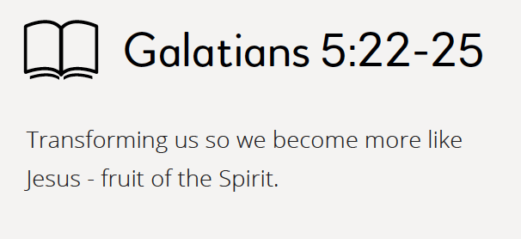
Being and doing
The New Testament highlights two areas in which the Spirit works in our lives.

Slide 57
Fruit of the Spirit
Fruit takes time to grow. How much of the following fruit have developed in your life? You might like to score your self - 0 being barely present in my life to 10, fully formed!
Love
Joy
Peace
Patience
Gentleness
Goodness
Faith
Meekness
Self Control

Slide 58
Gifts of the Spirit
The gifts given by the Holy Spirit are a bit like tools in a toolbox - they help us to do the jobs that Jesus gives us to do.
What gifts, talents, abilities and skills do you think you have?

Slide 59
Reflection

Slide 61
Welcome and review

Slide 62
Giving and receiving
What is the best gift you have ever received? What made it special?
Think about a gift that they have given to someone else that has been much appreciated. What made the gift special?
What has been the most special thing that anyone has ever done for you?
What has been the most special thing that God has ever done for you?

Slide 63
Insert Video Clip 6 here…

Slide 64
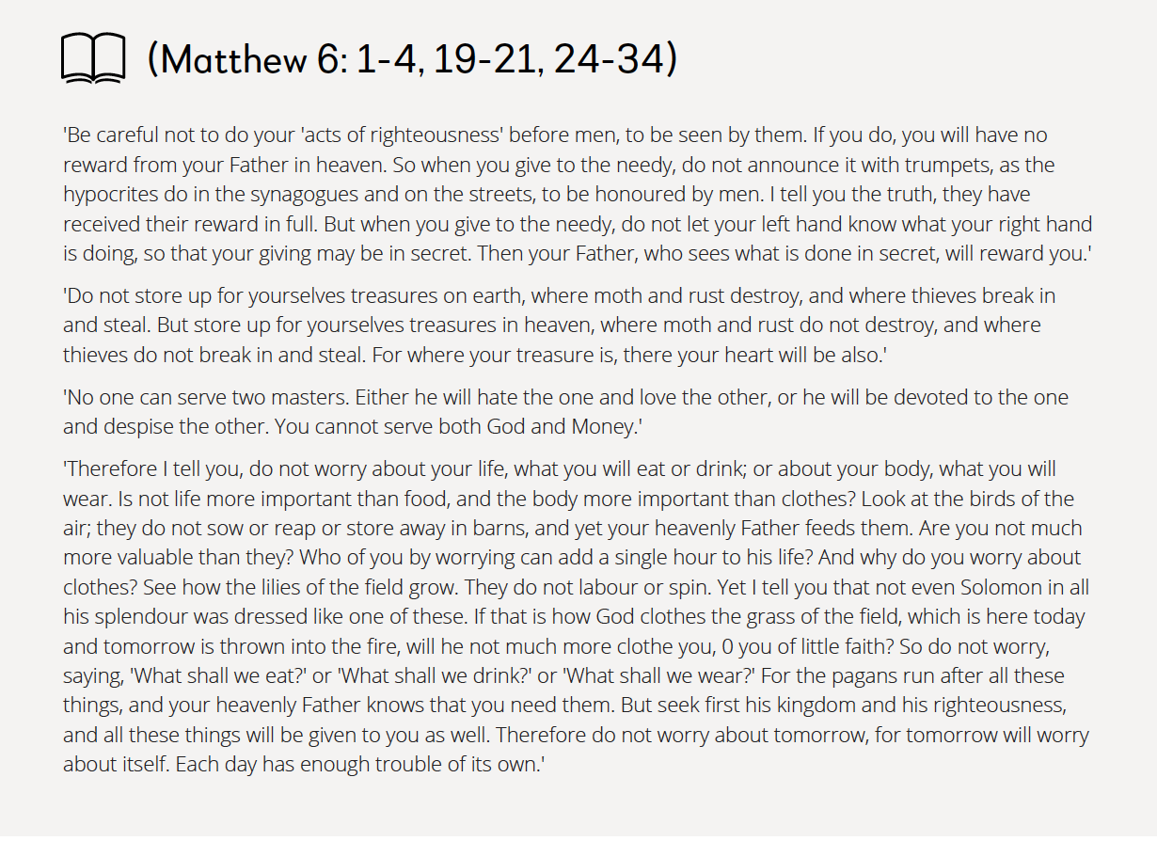
Money matters

Slide 65
Money matters
Which parts of the text from Matthew’s Gospel encourage you, challenge you or raise questions for you?
How do you react to thinking through these issues?
Is your response to Jesus teaching 'bang on target’?
Do you think you are wide of the mark?
Or are you 'there or thereabouts'?

Slide 66
Principles and practicalities
The Bible talks about giving a proportion of your income to God's work.
Some groups suggest that this should be 5% of our income and others recommend following the Bible's teaching about tithing which involves giving 10% of what we have to God. The Bible teaches that our giving to God should be realistic, planned, generous, regular and cheerful.
In most churches about 85% of the time, money, energy and prayer is given by about 15% of the people. Why do you think this is?

Slide 67
I will offer up my life
Giving isn't just about money; it's about offering ourselves totally to God. So as well as money we need to offer our time, talents and energy to God.
In the members' material there are some words from two Christian worship songs.
Underline some of the lyrics from these two songs that you feel best express this idea. You might like to share as a group which phrases were picked and why.

Slide 68
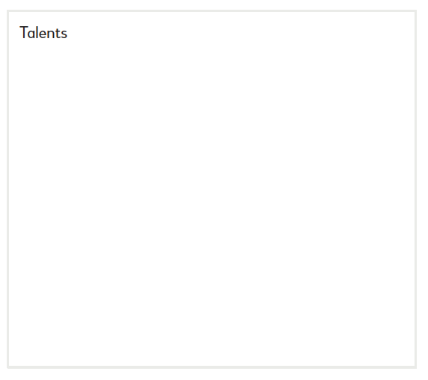
I will offer up my life
Looking at the boxes below (or writing in your participant manual) consider some of the things you might be able to offer to God and God’s church.

Slide 69
Reflection

Slide 71
Welcome and review

Slide 72
24/7/365
God is not just concerned what we do in church on Sunday but how we live from Monday to Saturday. Being a follower of Jesus is about being a disciple 24/7/365.
Inside thoughts as well as outward appearances
What we say with our tongue as well as what we do with our hands
Habits, old and new
How we use our home, time and money
The quality of our relationships
It's about joy as well as duty, receiving alongside giving.

Slide 73
Insert Video Clip 7 here…

Slide 74
New Creation
Since choosing to follow Jesus, in what ways do you feel like a new creation?

Slide 75
Spring Cleaning
Invite one or two of the members of the group to read Colossians 3: 12-17:

Slide 76
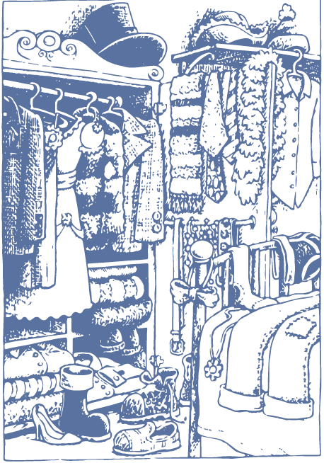
Spring Cleaning
Imagine your life is like a wardrobe full of clothes. The different 'clothes' in the wardrobe represent different attitudes, habits and values in your life.

Slide 77
Spring Cleaning
Going through your 'life wardrobe' what might need to go? What can stay? What might need to change?
Write in the boxes in your manual aspects of your life that can stay, need to be removed from your life or that might need to be altered.

Slide 78
Discipleship driving school
Look again at the picture of motorists we used in Sessions 1 (on the next slide. If discipleship is about being a learner, which car best represents our own journey with Jesus?

Slide 80
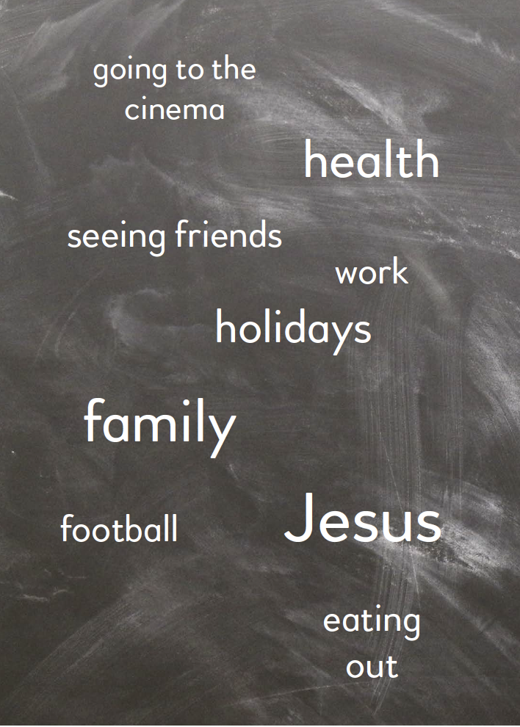
Jesus is Lord!
In the box below in your manual write down the various things that make up your life. You might like to write in different size print according to how important they are to you. You might also like to place them in the box according to whether they are central to your life and very important or just a fringe interest. Rather than using words you could draw pictures if you wish.

Slide 81
Act of commitment and take it away
This song makes the point the whole course has been working towards You can sing it together, or simply read the words:
Jesus, be the centre. Be my source, be my light, Jesus.
Jesus, be the centre. Be my hope, be my song, Jesus.
Be the fire in my heart
Be the wind in these sails
Be the reason that I live
Jesus, Jesus

